Slide 1
Source Code for User Stories

Slide 2
Github Repository
https://github.com/Team-3-MarketplaceSolution/DonationPlaceSolution

Slide 3
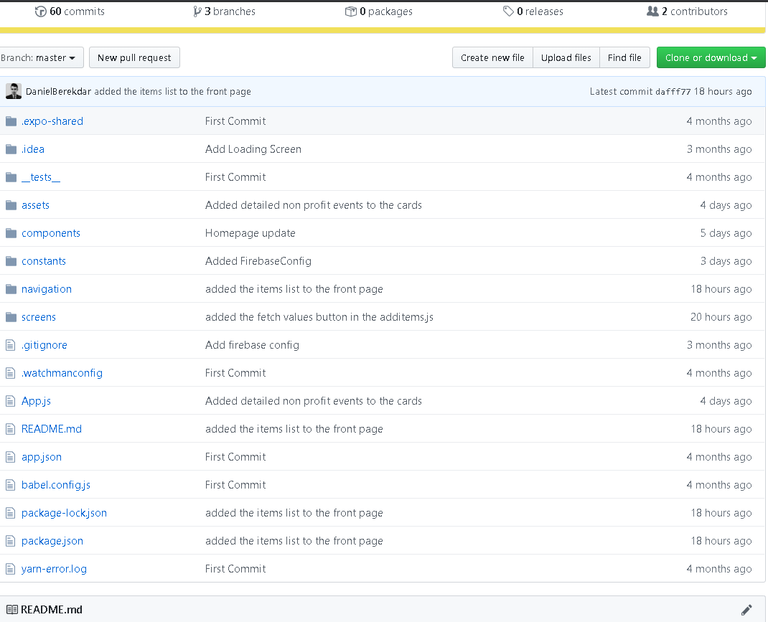

Slide 4
2.2 Change User Info
import React from 'react';
import {StyleSheet, Text, TextInput, TouchableOpacity, View} from 'react-native';
import * as firebase from "firebase";
import Colors from "../constants/Colors";
import SubmitButton from "../components/SubmitButton";
export default class SignUpScreen extends React.Component {
state = {
uid:"",
first_name: '',
last_name:'',
street1: '',
street2: '',
city: '',
state: '',
zip: '',
errorMessage: null
};
writeUserData = () =>{
console.log(this.uid);
firebase.database().ref('Users/'+this.state.uid).update(
{
first_name: this.state.first_name,
last_name:this.state.last_name,
street1: this.state.street1,
street2: this.state.street2,
city: this.state.city,
state: this.state.state,
zip: this.state.zip,
}
).then((data)=>{
alert("Information Updated!");
}).catch(error => this.setState({errorMessage: error.message}))
}
handleUpdate = () =>{
if(this.state.first_name.trim() === ''){
this.setState({errorMessage: 'Please fill in First Name!'});
}else if(this.state.last_name.trim() === ''){
this.setState({errorMessage: 'Please fill in Last Name!'});
}else {
this.writeUserData();
}
}
componentDidMount() {
const uid = this.props.navigation.getParam('uid');
console.log(uid);
this.setState({uid: uid});
firebase.database().ref('Users/'+uid).on('value',(data)=>{
console.log(data.toJSON());
this.setState(data.toJSON());
});
console.log(this.state);
}
render() {
return (
<View style={styles.container}>
<Text>{this.state.errorMessage}</Text>
<TextInput
style={styles.textInput}
autoCapitalize="none"
placeholder="First Name"
onChangeText={first_name => this.setState( {first_name})}
value={this.state.first_name}
/>
<TextInput
style={styles.textInput}
autoCapitalize="none"
placeholder="Last Name"
onChangeText={last_name => this.setState({last_name})}
value={this.state.last_name}
/>
<TextInput
style={styles.textInput}
autoCapitalize="none"
placeholder="Street1"
onChangeText={street1 => this.setState({street1})}
value={this.state.street1}
/>
<TextInput
style={styles.textInput}
autoCapitalize="none"
placeholder="Street2"
onChangeText={street2 => this.setState({street2})}
value={this.state.street2}
/>
<TextInput
style={styles.textInput}
autoCapitalize="none"
placeholder="City"
onChangeText={city => this.setState({city})}
value={this.state.city}
/>
<TextInput
style={styles.textInput}
autoCapitalize="none"
placeholder="State"
onChangeText={state => this.setState({state})}
value={this.state.state}
/>
<TextInput
style={styles.textInput}
autoCapitalize="none"
placeholder="ZipCode"
onChangeText={zip => this.setState({zip})}
value={this.state.zip}
/>
<SubmitButton click = {this.handleUpdate}>Submit</SubmitButton>
</View>
);
}
}
// LinksScreen.navigationOptions = {
// title: 'Links',
// };
const styles = StyleSheet.create({
container: {
flex:1,
justifyContent: "center",
alignItems: "center"
},
button: {
marginTop:20,
width:"80%",
backgroundColor: Colors.buttonColor,
borderRadius: 4,
height: 55,
alignItems: "center",
justifyContent: "center"
},
textInput: {
borderBottomColor: "#8A8F9E",
width: '80%',
borderBottomWidth: StyleSheet.hairlineWidth,
height: 40,
fontSize: 15,
color: "#161F3D",
marginTop: 10
},
});

Slide 5
3.1 Create Donation list
import React, { Component } from 'react';
import { AppRegistry } from 'react-native';
import { View, Text, Button } from 'native-base';
import GenerateForm from 'react-native-form-builder';
const styles = {
wrapper: {
flex: 1,
marginTop: 15,
},
submitButton: {
paddingHorizontal: 10,
paddingTop: 10,
},
};
const fields = [
{
type: 'number',
name: 'Shirts',
label: 'Shirts',
},
{
type: 'number',
name: 'pants',
label: 'Pants',
},
{
type: 'number',
name: 'jackets',
label: 'Jackets',
},
{
type: 'number',
name: 'sweaters',
label: 'Sweaters',
},
{
type: 'text',
name: 'inHonorOf',
label: 'Donate in Honor of Someone?',
},
];
export default class FormGenerator extends Component {
add() {
const formValues = this.formGenerator.getValues();
console.log('FORM VALUES', formValues);
}
render() {
return (
<View style={styles.wrapper}>
<View>
<GenerateForm
ref={(c) => {
this.formGenerator = c;
}}
fields={fields}
/>
</View>
<View style={styles.submitButton}>
<Button block onPress={() => console.log(this.formGenerator.getValues())}>
<Text>Create List</Text>
</Button>
</View>
</View>
);
}
}
AppRegistry.registerComponent('FormGenerator', () => FormGenerator);

Slide 6
3.2 Donation In Honor Of
import React, { Component } from 'react';
import { AppRegistry } from 'react-native';
import { View, Text, Button } from 'native-base';
import GenerateForm from 'react-native-form-builder';
const styles = {
wrapper: {
flex: 1,
marginTop: 15,
},
submitButton: {
paddingHorizontal: 10,
paddingTop: 10,
},
{
type: 'text',
name: 'inHonorOf',
label: 'Donate in Honor of Someone?',
},
export default class FormGenerator extends Component {
add() {
const formValues = this.formGenerator.getValues();
console.log('FORM VALUES', formValues);
}
render() {
return (
<View style={styles.wrapper}>
<View>
<GenerateForm
ref={(c) => {
this.formGenerator = c;
}}
fields={fields}
/>
</View>
<View style={styles.submitButton}>
<Button block onPress={() => console.log(this.formGenerator.getValues())}>
<Text>Create List</Text>
</Button>
</View>
</View>
);
}
}
AppRegistry.registerComponent('FormGenerator', () => FormGenerator);

